Slide 1
Chapter 1:
Overview of Computer Networks

Slide 2
Outline
Network Overview
Definition
Connectivity
Topologies
Categories
Internetworks

Slide 3

Motivations
Efficient way to share resources
Cost – less expensive
Accessibility – easier
Efficient way to exchange information
Time – faster
Size – bigger
Correctness – more accurate

Slide 4
Networks
Network: a set of devices connected by media links
Laptop
Workstation
Media Links
Server
Printer
Scanner

Slide 5
Types of Connections
Point-to-point
Multipoint (multidrop)

Slide 6


Point-To-Point Connection

Slide 7
Multipoint Connection
Wireless

Slide 8
Direction of Data Flow
Simplex: One direction only
data flow
Server
Monitor
data flow
Keyboard
CPU

Slide 9
Direction of Data Flow
Half Duplex: Both directions, one at a time
E.g., walkie-talkies
data flow at time 1
data flow at time 2

Slide 10

Direction of Data Flow
Full Duplex: Both directions simultaneously
E.g., telephone
Can be emulated on a single communication link using various methods
data flow
data flow

Slide 11
Topology
Topology: physical or logical arrangement of devices
Point-to-point
Mesh
Star
Bus
Ring
Hybrid

Slide 12
Point-to-Point Connection

Slide 13
Fully Connected Mesh Topology
E
A
D
B
C

Slide 14
Fully Connected Mesh Topology

Slide 15
Fully Connected Mesh Topology
Pros:
Dedicated links
Robustness
Privacy
Easy to identify fault
Cons:
A lot of cabling
I/O ports
Difficult to move

Slide 16
Star Topology
A
D
Hub
Drop
B
C
Drop

Slide 17
Star Topology
A
D
Switch
B
C

Slide 18
Star Topology
A
D
Hub
B
C

Slide 19
Star Topology
Pros:
One I/O port per device
Little cabling
Easy to install
Robustness
Easy to identify fault
Cons:
Single point of failure
More cabling still required
Hub

Slide 20
Bus Topology
Drop
line
Tap
Terminator

Slide 21
Bus Topology
A
B
C
D

Slide 22
Bus Topology

Slide 23
Bus Topology
Pros:
Little cabling
Easy to install
Cons:
Difficult to modify
Difficult to isolate fault
Break in the bus cable stops all transmission

Slide 24
Ring Topology
C
D
B
A

Slide 25
Ring Topology

Slide 26
Ring Topology
Pros:
Easy to install
Easy to identify fault
Cons:
Delay in large ring
Break in the ring stops all transmission

Slide 27
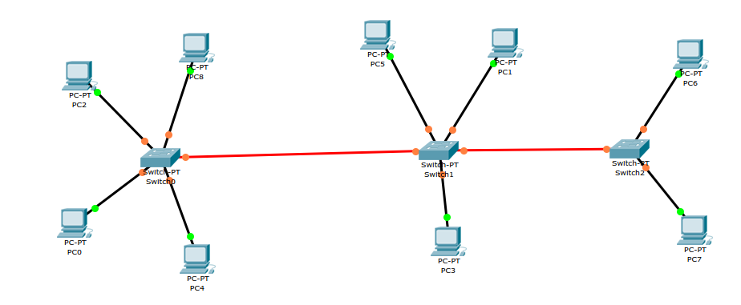
Hybrid Topologies

Slide 28
Network Categories
Local Area Network (LAN)
Wide Area Network (WAN)

Slide 29
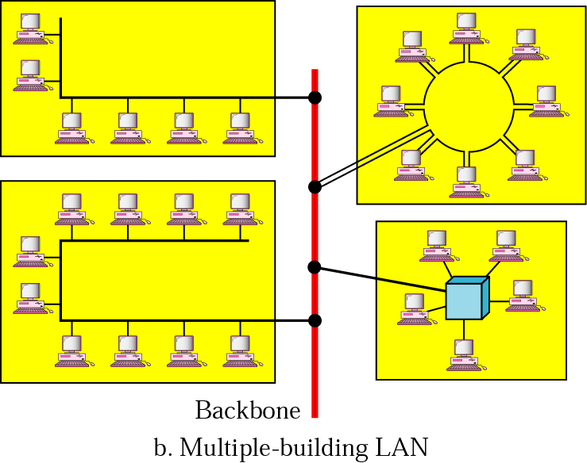
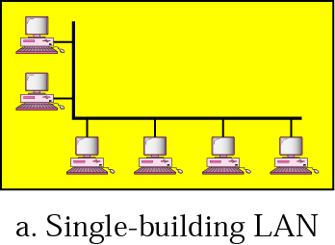
Local Area Networks
Network in a single office, building, or campus

Slide 30
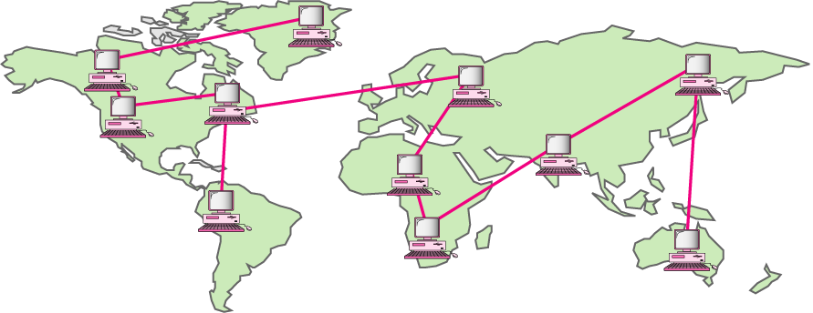
Wide Area Networks
Network providing long-distance communication over a country, a continent, or the whole world

Slide 31
WAN Technologies
Circuit Switching
Physical links are dedicated between two points
Packet Switching
Data are put in packets which are stored and forwarded at each node
Virtual Circuit Switching
Virtual links are established between two points
→ Frame Relay and ATM (Asynchronous Transfer Mode)

Slide 32
Circuit vs. Packet Switching
Early communication networks
Dedicated circuit
Electronic switches are used
Circuit switching
In 1960s, packet switching concept revolutionized data communications
Provides the basis for the modern Internet
Allows multiple users to share a network
Divides data into small blocks, called packets
Includes an identification of the intended recipient in each packet

Slide 33



Switching
Dedicated circuits
Circuit switching
Telephone switches
establish circuits
for communication
Packet switching
Data are put into
packets
Each stamped with
source and destination
addresses
Routers know where to
forward packets
telephone
switch
Packet
Router

Slide 34
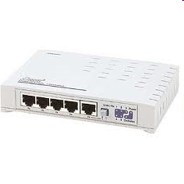
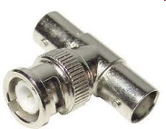
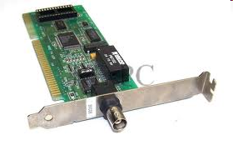
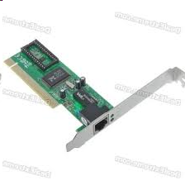
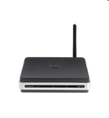
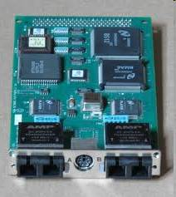
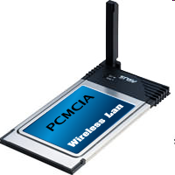
Network of Networks
Company A
Company B
Network Interface Card (NIC)
Company C
Company D

Slide 35

Internetworking
How to allow devices from different standards to communicate
Gateways/routers – devices capable of communicating in several standards
These become "network of networks"

Slide 36
Internetworks
Two or more networks connected become an internetwork, or internet
Example: The Internet
Network1
Network2
Gateway
Network3

Slide 37
The Internet
The largest internetwork (network of networks) in the world
Devices communicating with TCP/IP protocol suite
Stanford
U. of Utah
UC Santa Barbara
UCLA

Slide 38
Summary
Data communication
Protocols and standards
Computer networks
Topologies
LAN/MAN/WAN
Internetworks (networks of networks)

